Slide 1
Understanding Public Opinion
Sentiment Analysis Using AI on Twitter & Reddit

Slide 2

Introduction
This presentation explores the automated analysis of public opinion on social media platforms, specifically Twitter and Reddit, through sentiment analysis. The key focus revolves around how businesses can leverage this technology to enhance brand reputation and respond effectively to customer sentiments.

Slide 3
01
Project Importance

Slide 4
Impact of social media on brand reputation
Social media platforms play a critical role in shaping public opinion and influencing brand perception. A single tweet or Reddit comment can reach thousands of users, leading to a rapid spread of sentiment, either positive or negative. Companies must monitor these platforms closely to maintain a favorable reputation and address any issues that may arise.

Slide 5
Limitations of manual analysis due to high volume
The sheer volume of posts on social media makes manual analysis impractical. With millions of tweets and comments generated daily, businesses face challenges in tracking sentiments effectively. Automated sentiment analysis solutions become essential to process large datasets efficiently and extract meaningful insights that inform marketing strategies and crisis management.

Slide 6

Goal of automating sentiment analysis
The primary objective of automating sentiment analysis is to enhance the efficiency and accuracy of understanding public opinion from social media. By implementing automated systems powered by natural language processing (NLP), businesses can classify sentiments expressed in posts as positive, negative, or neutral, leading to timely insights for decision-making. This will enable brands to adapt their strategies proactively and engage effectively with their audience.

Slide 7
02
Data Insights

Slide 8
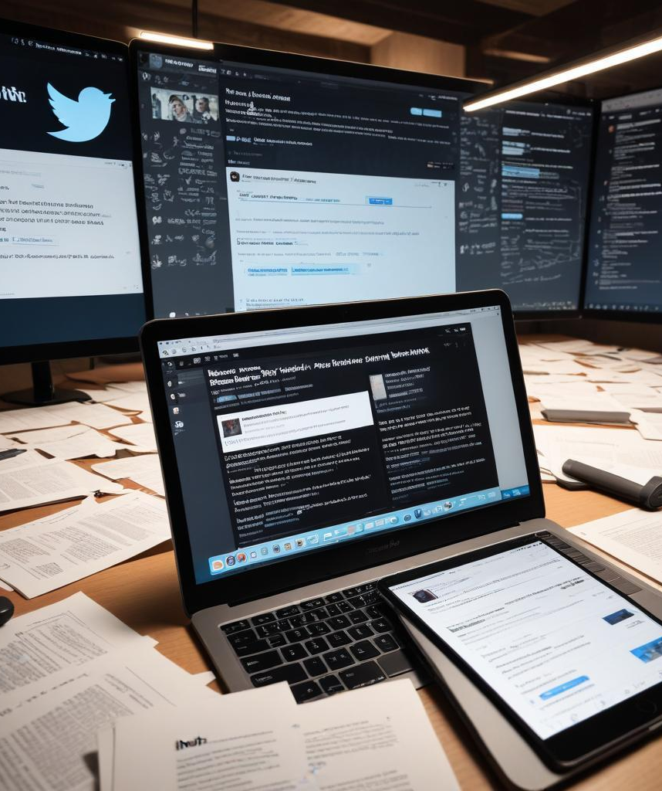
Overview of Twitter and Reddit datasets
The study utilizes datasets from both Twitter and Reddit to capture public sentiment. The Twitter dataset consists of posts labeled as positive, negative, or neutral, while the Reddit dataset comprises comments that provide a deeper conversational context. Combined, these datasets encompass approximately 99,400 posts, allowing for comprehensive sentiment analysis across platforms.

Slide 9
Key findings from exploratory data analysis
Exploratory data analysis revealed significant trends in sentiment across both platforms. The sentiment distribution showed a predominance of neutral sentiments, followed by negative and positive classifications. Additionally, Twitter generated more posts overall, whereas Reddit exhibited a skew towards negativity, indicating varying user engagement and emotional expression across platforms.

Slide 10
Sentiment distribution and implications for business
The analysis of sentiment distribution provides valuable insights for businesses. Neutral sentiments, being the most prevalent, should not be overlooked; they require careful interpretation to clarify brand messaging. In contrast, the negativity observed in Reddit posts can be leveraged as constructive feedback for product or service improvement. Understanding these dynamics enables brands to tailor their communication strategies effectively.

Slide 11

Conclusions
The analysis underscores the importance of automated sentiment analysis in understanding public opinion. By effectively processing large volumes of data from platforms like Twitter and Reddit, businesses can respond more rapidly to consumer feedback, enhance their reputation, and foster a positive brand image through strategic actions based on sentiment insights.

Slide 12
Thank you!
Do you have any questions?
+91 620 421 838

